Slide 1
Diabetes Mellitus associated SNP Detection Algorithm
ayar Mansour
uhammad Elsadany
M

Slide 2
Objectives
Intro
Proposed Algorithm
Data
&
Experiment
&
Results
Conclusion

Slide 3
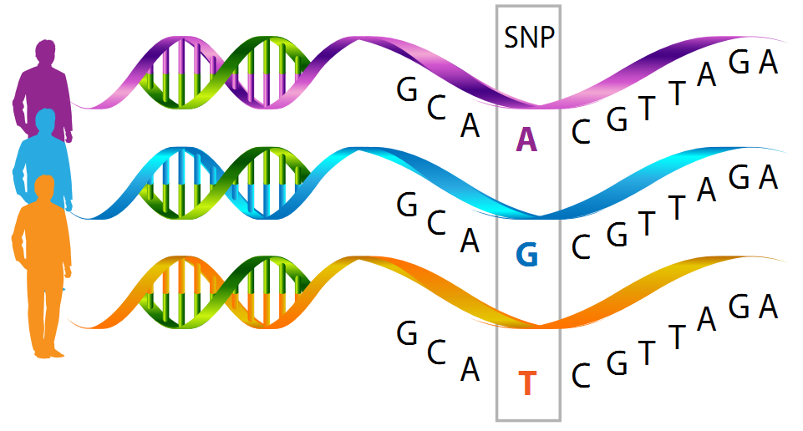
About us (SNPs & Diabetes Mellitus)
SNPs
Are the most common type of genetic variation among people where a single nucleotide change from one individual to the other in the same species (figure 1).
Scientists found that they occur almost once every 1000 Nucleotide [1].
They can act as biological markers, helping scientists locate genes that are associated with diseases [1].

Slide 4
About us (Cont.)
SNPs
Importance
They may help predict an individual’s response to certain drugs.
Predict susceptibility to environmental factors such as toxins, and risk of developing particular diseases.
They also can be used to track the inheritance of disease genes within families.
We will focus on detecting SNPs associated with complex diseases such as diabetes

Slide 5
About us (Cont.)
Diabetes Mellitus
A chronic disease that occurs either when the pancreas does not produce enough insulin or when the body cannot effectively use the insulin it produces
In 2016, it was the direct cause of 1.6 million deaths [2].
Moreover, Poorly controlled diabetes over time leads to serious damage to many of the body’s systems, especially the nerves and blood vessels [2].

Slide 6
Proposed Algorithm

Slide 7
Hash Position index Algorithm
Using the hash algorithm, the four bases are converted into four binary digits, and then the conversion sequence is converted, which is set A=1, C=1=2, G=3, T=4,and then convert the four numbers to decimal digits in the matching query .
Hash value algorithm formula is Hash(value)=value*[4^(2*k-m-1)], value represents the corresponding value of the character, K represents the length of M, and k-mer represents the position range of the character in the string [0- (m-1)]

Slide 8
Pipeline
First, we built a database specific to all the SNPs found in the insulin gene that are correlated clinically to being pathogenic or likely pathogenic. These SNPs were extracted from the dbsnps in the NCBI.
Second, we worked on a sequence matching algorithm based on hash position index. This step is to compare the entered sequence from the user with the original gene sequence.
Third, we check the differences between both if present and get back the nucleotides position.
Fourth, we fetch the database searching for the position and its clinical pathogenicity and if not found it gives a “not defined pathogenicity” statement.

Slide 9
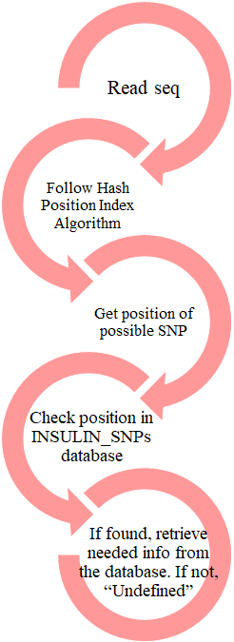
Follow me

Slide 10
Data & Experiment & Results

Slide 11
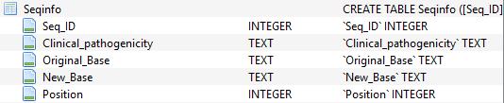
Data & Experiment & Results
Data
As mentioned before, the user will enter the sequence to be checked in a FASTA file.
The original sequence of Insulin gene was retrieved from https://www.ncbi.nlm.nih.gov/projects/CCDS/CcdsBrowse.cgi?REQUEST=GENEID&DATA=3630&BUILDS=CURRENTBUILDS
The database records that were entered by a python code.

Slide 12

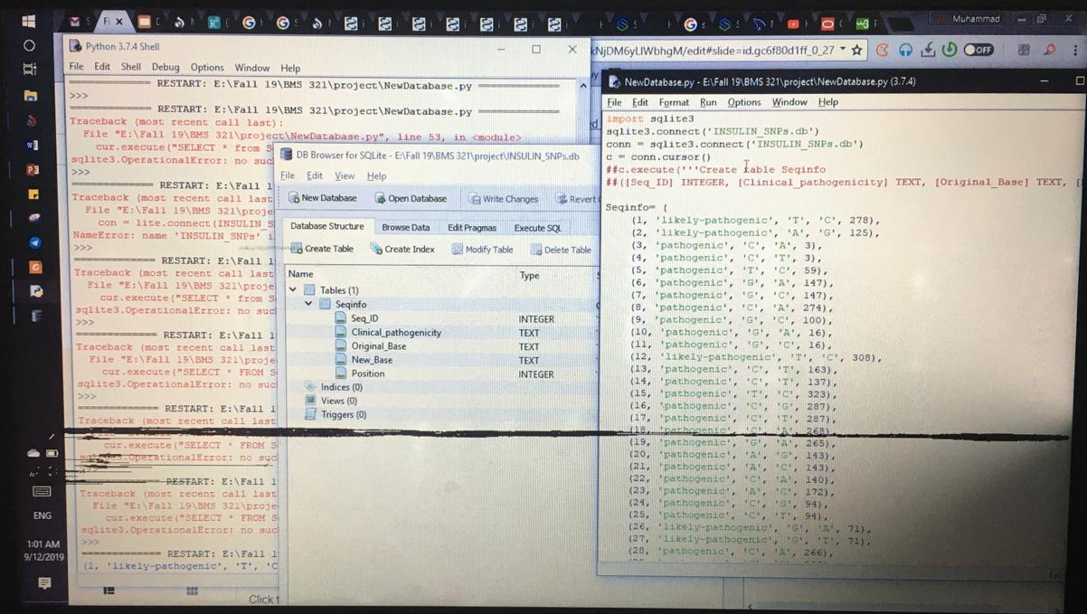
Experiment & Coding
Experimenting the code was done by using known sequences of specific SNPs that are already recorded in the database
The coding part was mainly categorized into 3 parts: (reading file and Hash Algorithm - building database - getting position of SNP and retrieving data from database)

Slide 13
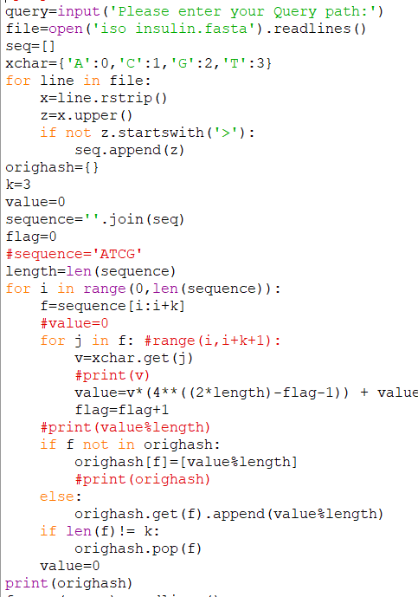
Coding part 1

Slide 14
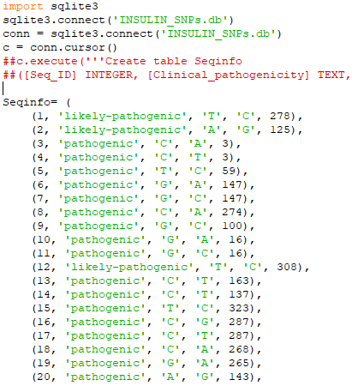
Coding part 2

Slide 15
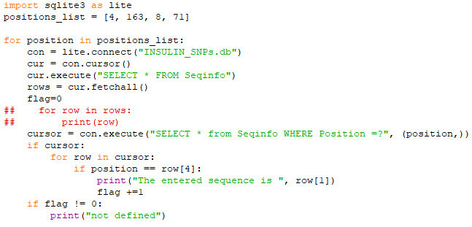
Coding part 3

Slide 16
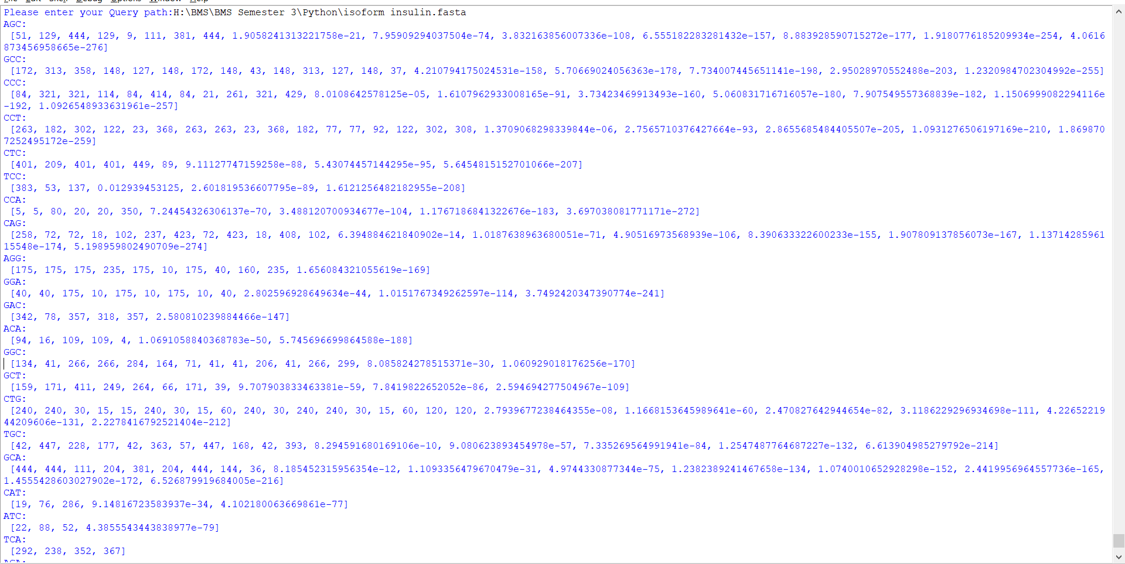
Data & Experiment & Results
Results

Slide 17
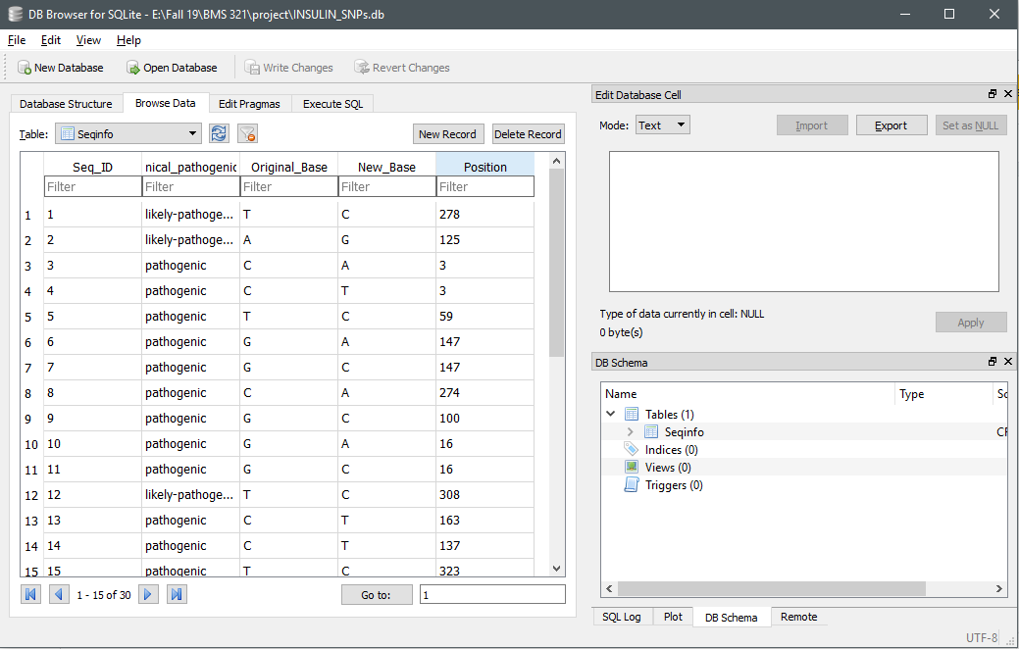
Data & Experiment & Results
Results

Slide 18
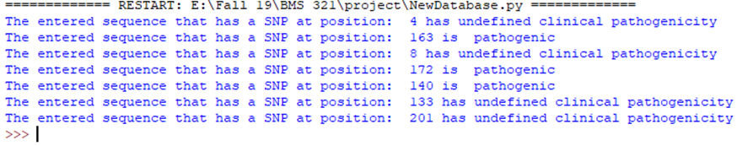
Data & Experiment & Results
Results

Slide 19
Data & Experiment & Results
Results
Evaluating Results:
Checking needed output of the position needed
Checking known SNPs of insulin gene with known sequences
Checking the value of Hash position index algorithm output

Slide 20
Conclusion

Slide 21
Conclusion
Limitations
Our database does not include benign SNPs
Insulin has multiple variants due to alternative splicing
Insertions or deletions within the entered sequence
For sequences with multiple SNPs, the code will give the possible clinical pathogenicity for each SNP not the overall as it’s not defined

Slide 22
Conclusion
Recommendations
Since our code gives the possible clinical pathogenicity for multiple SNPs, we recommend trying to affirm our results using experimental approaches

Slide 23
References

Slide 24
References
[1] G. Reference, "What are single nucleotide polymorphisms (SNPs)?", Genetics Home Reference, 2019. [Online]. Available: https://ghr.nlm.nih.gov/primer/genomicresearch/snp?fbclid=IwAR0tJhUIP2QNuNm9bjo5Yq4zbO2ltlAVPtuK6NBkU8xf9EAeQNJK2VU5uCY. [Accessed: 11- Nov- 2019].
[2] "Diabetes", Who.int, 2019. [Online]. Available: https://www.who.int/news-room/fact-sheets/detail/diabetes. [Accessed: 11- Nov- 2019].

Slide 25
ThanQ

